Slide 1
Chapter 7
The American Revolution

Slide 2
Section 1: The Revolution Begins

Slide 3
First Continental Congress
In September 1774, the First Continental Congress met in Philadelphia. 56 colonial delegates met from 12 of the colonies (all colonies had sent delegates except Georgia).

Slide 4
At this meeting, the delegates determined what to do about the crisis in Massachusetts and the British abusing their authority. They determined:
Continue their boycott of British goods
Warn their militias to be prepared to assemble if violence broke out
Wrote a Declaration of Resolves (list of 10 resolutions to be sent to the King that stated their rights)
They decided to meet again in May 1775 if the king didn’t acknowledge these rights.

Slide 5
Shot Heard Round the World
In April 1775, British general Thomas Gage received orders to seize Boston militia’s weapons, which were stored in Concord (a city 20 miles west of Boston).
Gage tried to keep the plan a secret, but spies informed the Sons of Liberty of the plan.

Slide 6
On April 18, 1775, Paul Revere and William Dawes received word that the British were crossing the Charles River to march toward Concord. They hopped on their horses and warned the militia that the “British were coming”.

Slide 7
The next morning, 70 militia members met the British troops at Lexington (a town near Concord).
A shot was fired and no one knows which side fired the shot, but the battle began. Minutes later, it was over and the outnumbered militia suffered 8 dead and 10 wounded soldiers.

Slide 8
The British marched on to Concord in search of the weapons, but did not find any because they were already hidden.
As the British retreated to Boston, they were fired upon by the colonists. By the time the British reached Boston, they suffered 250 casualties, in comparison to the 100 colonist casualties.

Slide 9
Second Continental Congress
May 1775: representatives from 12 of the 13 colonies met in Philadelphia to determine how to act. They decided:
Not to break away from Britain
Organize a Continental Army with George Washington as the army commander
Wrote the Olive Branch Petition to try to restore peace with Britain.

Slide 10
During the meeting of the Second Continental Congress, battles continued between the colonists and the British:
Fort Ticonderoga: battle over controlling Lake Champlain and a waterway access to Canada. (colonist victory)
Bunker Hill: even though the colonists retreated, this battle demonstrated that the colonists could withstand an assault from the British army.
Dorchester Heights: the colonists defeated the British troops with well positioned cannons.

Slide 11
7.1 Questions
1. What was Paul Revere’s role in the fighting and Lexington and Concord?
2. Why do you think that the First Continental Congress met? (Think back to end of Chapter 6)
3. What was accomplished at the meeting of the Second Continental Congress?

Slide 12
Section 2: Declaring Independence

Slide 13
After learning of the battles, King George III declared the colonies in a state of rebellion on August 23, 1775. (The Olive Branch Petition written by the Second Continental Congress reached King George on August 24—too late)

Slide 14
Both sides prepared for war:
Great Britain enlarged their army by hiring mercenaries (soldier who serves for pay in the military of a foreign government) from Germany known as the Hessians. Great Britain also called on Indian allies that were angry at the colonists for ignoring the Proclamation of 1763.
The colonies created a navy, established a marine corps, and sought alliances with Indians. Also, Georgia joined the Second Continental Congress in September 1775.

Slide 15
Even though the colonies were already at war, some colonists believed the problems could be settled peacefully. Thomas Paine wrote a pamphlet in 1776 called Common Sense that influenced the public’s opinion of the war. He:
Questioned the right of the king to rule
Stated that people should rule themselves
Demanded people cut their ties with the British government
Called for a revolution
This pamphlet became very popular and sparked discussions of independence among colonists.

Slide 16
Independence was also discussed in the Second Continental Congress. After much debate, the Congress appointed a committee to write a document declaring their independence, with Thomas Jefferson as the primary author. It took Jefferson about 17 days to write what became known as the Declaration of Independence.

Slide 17
The Declaration of Independence can be divided into 3 parts:
Preamble: Introduction that stated by the Declaration was needed.
Described the colonists’ main ideas about government
Listed the complaints against the king and Parliament, and listed the ways the colonists tried to peacefully settle their differences. At the end, Jefferson wrote the colonies were free and independent states.

Slide 18
June 28, 1776: the Declaration was read aloud to the Congress. For several days it was discussed and changes were made.
July 4, 1776: Congress voted to give its final approval for the Declaration.
August 2, 1776: A formal copy was signed by the members of the Congress.

Slide 19
7.2 Questions
What role did Thomas Paine’s pamphlet play in the colonies’ independence?
How do you think history could be different if King George III had received the Olive Branch Petition in time?
What are the three parts of the Declaration of Independence? Which part do you think is most important? Why?

Slide 20
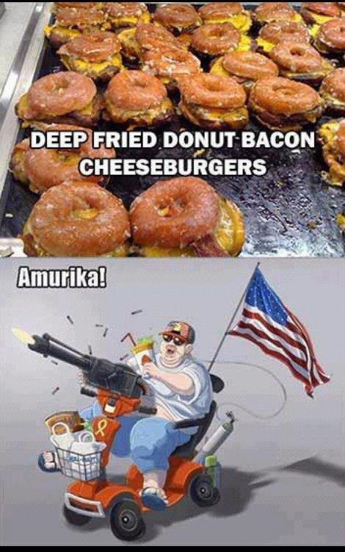
Enjoy the weekend ☺

Slide 21
Section 3: Dark Times

Slide 22
How does the Declaration of Independence affect the colonists?
Those who supported the Revolution would be considered traitors to Britain, which left a divide between the colonists.
Patriots: colonists who chose to fight for their independence
Loyalists: colonists that remained loyal to Britain
Neutral: some colonists took neither side and were willing to accept whatever the outcome of the war would be.

Slide 23
Even though the declaration stated “all men are created equal”, the document left out slaves and women.
The original draft of the Declaration of Independence condemned the slave trade (spoke against it/disapproved). However, the southern delegates objected to this passage so it was removed from the final draft.

Slide 24
In July 1776, slavery was legal in all of the colonies. However, the Revolution began to spark debates about slavery in a society that valued liberty.
Within the next few years, some New England colonies would begin to take steps to end slavery.

Slide 25
Washington debated whether or not to recruit African American soldiers in the Continental Army, since there were many that were already serving in the militias. About 1 out of every 5 people living in the colonies was of African descent. Many southerners opposed this idea, so Washington issued an order prohibiting African Americans from serving in the army.

Slide 26
After Washington declared no African Americans in the Continental Army, the royal governor of Virginia issued a statement known as Lord Dunmore’s Proclamation, which promised freedom to any slave willing to fight for the British. Thousands of slaves responded to this promise, which forced Washington to change his policy and allowed free African Americans to enlist.

Slide 27
The British were more successful in recruiting American Indians than the colonists. Many Indian tribes hated the colonists for ignoring the Proclamation of 1763 and settling west of the Appalachians and were willing to fight against them.
The British also hired mercenaries from Germany known as the Hessians

Slide 28
Women in the Revolution
Many ran farms and businesses while men were away fighting
Some women worked at the army camps and served as nurses, spies, or messengers. They also cooked food, washed clothes, and carried water to soldiers on the battlefield.
A few women disguised themselves as men to fight in the war
Most helped with the cause by raising money for supplies and organizing sewing groups to make clothing

Slide 29
7.3 Questions
What was the difference between a Patriot and a Loyalist?
What groups were recruited to fight for the British?
3. What were some of the ways that women contributed to the Revolutionary War?

Slide 30
Section 4: New Hopes

Slide 31
At the beginning of the war:
 | Advantages | Disadvantages
Great Britain | Financial resources available Soldiers were mostly well trained professionals Greater numbers (at any point, they had 50,000 soldiers) Powerful navy | Citizens were hostile to the troops Had to ship supplies across the Atlantic Ocean, which took time Some soldiers were mercenaries (hired foreign soldiers) They were not very invested in the war
Colonies | The majority of the population supported the war They were fighting for a cause they believed in | No navy No organized army (relied mostly on militias until Continental Army was formed) Lower numbers (only about 15,000 soldiers at any point) Lack of financial resources

Slide 32
The Patriots experienced a few early victories, but the first years of the war were very rough.
On New Years Eve 1775, the Patriots lost about one-third of their army fighting the British in Quebec.
In the Summer 1776, the Patriots had over 1,000 casualties while fighting the British in New York and were forced to retreat.

Slide 33
Confident after these victories, British General Howe allowed his troops to rest for Christmas and New Years’ in 1776 before planning to advance onto Philadelphia.
On Christmas night 1776, Washington and 2,400 soldiers marched across the Delaware River and marched towards Trenton, NJ. Early on December 26, the Patriots launched a surprise attack known as the Battle of Trenton, that lasted less than an hour. The Patriots captured 900 Hessians with only 5 Patriot casualties.

Slide 34
Battle of Princeton
January 3, 1777: Washington’s troops moved onto Princeton, NJ. The Patriots fooled the British by leaving their campfires burning, and snuck out of camp to circle around the British and attack them from behind. The Patriots successfully drove back British forces.

Slide 35
These defeats led the British to attempt to execute a new strategy by cutting off New England from the rest of the colonies, but were unsuccessful.
British troops led by General Burgoyne met Patriots at the Battle of Saratoga. The British troops were significantly outnumbered and had to formally surrender to the Patriots on October 17, 1777.

Slide 36
The victory at Saratoga boosted foreign countries’ support of the Patriots.
France had been secretly supplying the Patriots with weapons, but after the Battle of Saratoga formally declared their support. A peace treaty was created in 1778
Spain had been secretly supplying the Americans also and formally allied with France in 1779. The majority of their support was aiding in battles along the Mississippi River.

Slide 37
Winter at Valley Forge
After the victory at Saratoga, Washington settled his troops in Valley Forge, PA.
The Continental Army was running low on supplies. Over the harsh winter of 1777-1778, about one-fourth of the soldiers died.
February 1778, Prussian officer Baron von Steuben helped Washington organize the army by providing basic training and military drills.

Slide 38
Naval War
In the fall of 1775, the Continental Congress decided to create a navy. In February 1776, 8 merchant vessels had been adapted for combat. Shortly after, the Continental Navy attacked the British naval supply base in the Bahamas. After successfully capturing the base, the Continental Navy focused on seizing British supply ships and weakening the naval forces.

Slide 39
After the French officially declared their support for the Patriots, the French navy aided the Continental Navy.
The Patriots used fewer than 100 of their own ships over the course of the war. Nevertheless, the British lost more than 200 ships to the small but effective Continental Navy.

Slide 40
7.4 Questions
1. Why can the Battle of Saratoga be considered a turning point in the American Revolution?
2. What type of strategy did Washington use for capturing Trenton and Princeton?
3. Why did Spain and France decide to support the Patriot cause?

