Slide 1
The Crusades

Slide 2
What were the Crusades?
The Crusades were a series of Holy Wars fought over ownership of Jerusalem
To go on a crusade meant going to fight for Christ.
There were 8 crusades in all that took place over about 150 years (1095-1250)

Slide 3
Jerusalem
Three major religious groups all claimed Jerusalem in the land of Palestine as their holy city:
To Christians: it was the place where Jesus was crucified and ascended to heaven
To Muslims: it was the place where Muhammad ascended to heaven
To Jews: it was the site of the ancient temple built by Solomon

Slide 4
Jerusalem
In 600 CE, Arabs entered the city and took control.
These Arabs allowed Christian and Jewish pilgrims to visit Jerusalem.
In fact, Jews and Christians could live in Palestine as long as they paid their taxes like everyone else.

Slide 5
What caused the Crusades?
Around 1095, a new group of Arabs (Turkish Muslims) took control of Jerusalem. They were not tolerant of Christians and began to ill-treat them.
Closed the city to Jewish and Christian pilgrims.
Robbed, tortured, massacred Christians that were there.
Pope Urban II called for a crusade at the request of Byzantine Emperor Alexius Comnenus

Slide 6
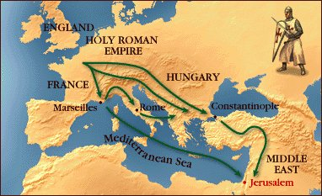
Travel Routes: 2 years

Slide 7
Who fought in the Crusades?
The pope called for a volunteer army whose goal was to retake Jerusalem.
A crusader varied from a high ranking knight to a peasant.
Many people volunteered. About 30,000 soldiers and 10,000 knights left Western Europe to fight in Jerusalem.

Slide 8
Why did people volunteer?
Knights
Chance to use their fighting skills, something they enjoyed and did well. They were delighted to have such a worthy battle to fight.
Peasants
Chance to escape their dreary life in the feudal system. The pope promised that if they died, they would automatically be welcomed into heaven.

Slide 9
Why did people volunteer?
Others
Chance to have adventure or even get rich.
Many crusaders were made noble as a result of their dealings during the Crusades.

Slide 10
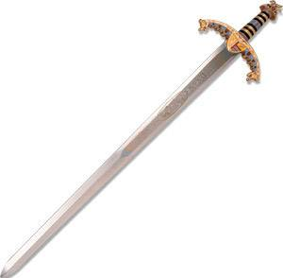
Crusaders weapons
Sword
used in hand-to-hand combat.
Dagger
used in hand-to-hand combat
Lances
used for charging at enemies, they were usually over 10 feet long

Slide 11
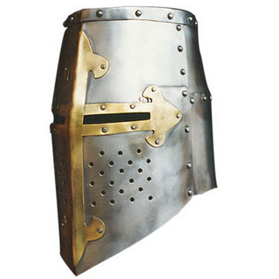
Crusaders Armor
Helmet
First and second crusade they were made of chainmail. After that they were made of steel.
Shield
Thick and triangular, they were made of wood and leather
Chainmail
Protected their bodies

Slide 12
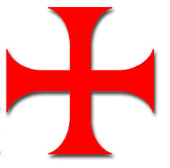
Sign of the Crusade
The Red Cross
Each crusader had a huge, red cross, made out of fabric stitched onto their shirts or armor.
It made all crusaders, irrespective of rank or background appear to be a unified army.
It reminded crusaders that they were fighting a holy cause.

Slide 13
Sign of the Crusade
The cross that appears on the shield was common during the Crusades.
It represented God and the righteous beliefs with which the Crusaders fought their campaign
The red cross was added to flags and banners

Slide 14
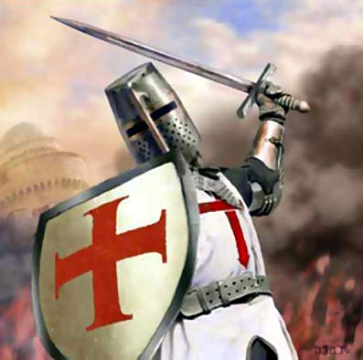
Crusader

Slide 15
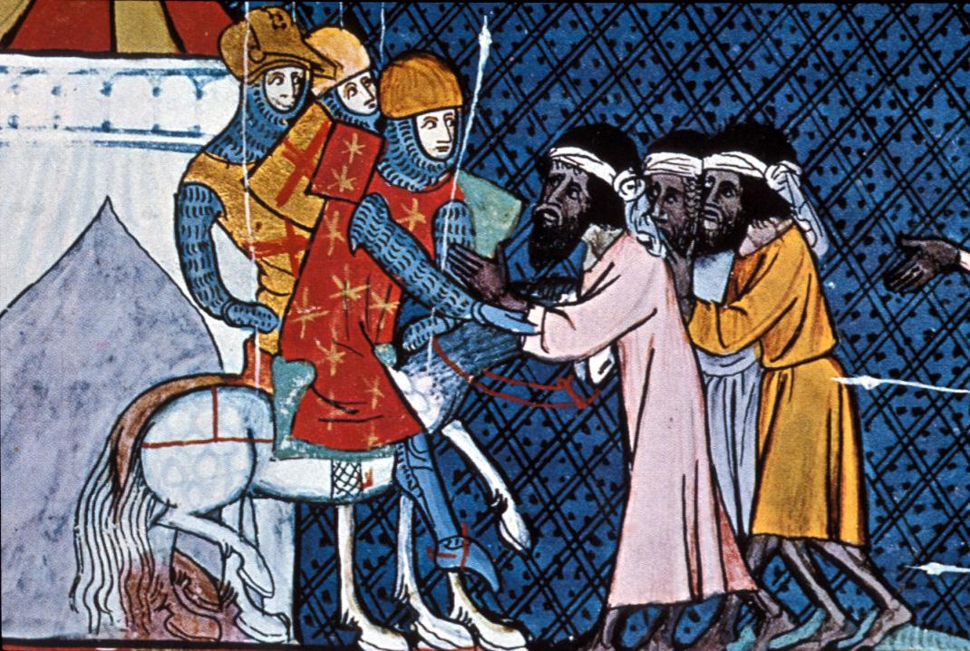
First Crusade
After about 2 years of traveling, the crusaders arrived in Jerusalem. After a 2 month siege, the city fell and the crusaders won Jerusalem back.
This victory was brief, the Muslims soon retook Jerusalem under their control.

Slide 16
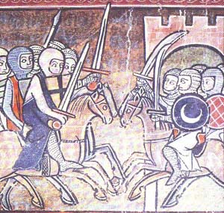
Other Crusades
Second Crusade: 1147-1149
Third Crusade: 1189-1192
Fourth Crusade: 1202-1204 (Constantinople)
Children’s Crusade: 1212

Slide 17
Other Crusades
Over the next 70 years, there were several other attempts but were all unsuccessful.
By 1291, European leaders admitted defeat and stopped asking for new crusaders.
Jerusalem was owned by Islam until the 20th century.

Slide 18
Crusades Newsletter
Imagine that you are a bishop working for the Pope. The Pope has asked you to create a newsletter that will be sent to all the kings and nobles in Europe. The purpose of the newsletter is to persuade Europe’s leaders to go on a Crusade in the Holy Lands, so you must convince the leaders to support the Pope in this endeavor.
This assignment is due Monday.

